Slide 1
Applied Data Science Capstone: The best Location for Opening a Mediterranean Restaurant in Toronto
by Maria

Slide 2
Introduction/Business Problem
Idea: Thinking about create a new bussiness of Mediterranean Restaurant. Where is the best location for it? Location is really important to have a successful restaurant, demand, people and neighboorhood need to be analize.
Purpose: The purpose is find the best location for opening a Spanish Restaurant in Toronto
The possibilities of mediterranean food from Spain as an unique restaurant with quality and making the difference with other restaurants of the area. I will focus on find the best location for the restaurant, in a Good neighboorhod with potential clients and no so much competitors, although in an area with more restaurants to be sure the people loves go there for leisure.
Target Audience: This can help people who want to open a Mediterranean restaurant in Toronto, or people with this business thinking about move the restaurant to another neighboorhood.

Slide 3
Data Sources
- For the Toronto neighborhood data: Wikipedia page, https://en.wikipedia.org/wiki/List_of_postal_codes_of_Canada:_M As we did in week3 of this Capstone I will read this data. I will create an structured format with the information of postal code, Borough and neighborhood.
- Then with “https://cocl.us/Geospatial_data” csv file to get all the geo coordinates
- Then I will use Foursquare API to find the restaurants of the area

Slide 4
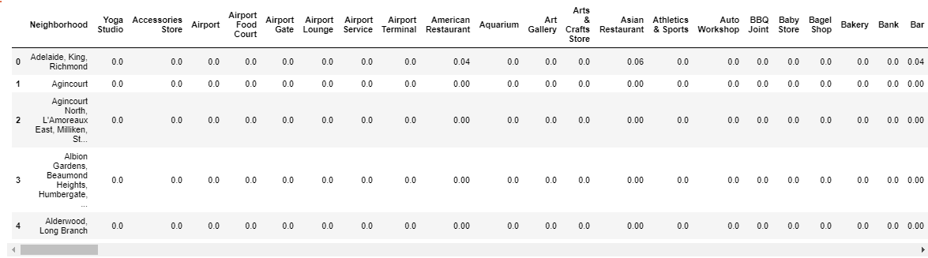
Managing the data
I read the data from Wikipedia for postal codes of Canada and remove the boroughs not assigned. Then group by postal code.
I add the coordinates for postal code
Then using Foursquare API I find all the venues per neighborhood.

Slide 5
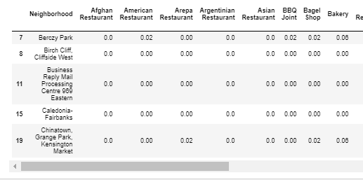
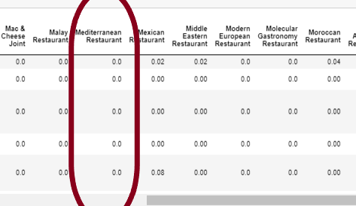
Models and conclusions
Now is the time to create models to see if open a Mediterranean Restaurant is a good idea or not
We can see the restaurants per neighborhood to check there are a loto f them without competitors, no other Mediterranean Restaurants. That is great!:

Slide 6
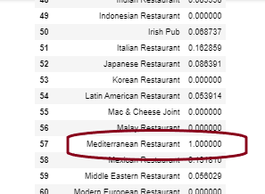
Good idea!
And we can see the Pearson correlation for Mediterranean Restaurant is strong:
So, open a Mediterranean Restaurant is a Good idea in Toronto, we can choose in all of those neighborhoods to entrepreneur.
Thanks for Reading.

